Slide 1
PARASITOLOGY (BIOL 460)
UNIT 6 A
TREMATODES (FLUKES)

Slide 2
TREMATODES (FLUKES)
As trematode worms the flukes possess features of the Class Trematoda of the Phylum Platyhelminthes (the Flatworms).
Members of the class which are of medical importance can be placed into two main groups on the basis of hermaphroditism
On this basis, there are those that are hermaphroditic and those that are not (non-hermaphroditic).

Slide 3
TREMATODES (FLUKES) CONT’D
The hermaphroditic flukes are further categorised on the basis of adult worm location/residence in the human or vertebrate host. There are three main such groups namely;
  Those of the liver, the lungs and the intestines
Being hermaphroditic, they have both male and female reproductive organs.

Slide 4
TREMATODES (FLUKES) CONT’D
General features of hermaphroditic flukes that infect humans
  Adults live according to the species, in the bile ducts, the intestinal tract or the lungs
  Animal reservoir hosts are involved in the transmission of some species

Slide 5
TREMATODES (FLUKES) CONT’D
  Transmission is by ingesting infective metacercariae which develop into the fluke and produce operculated eggs
  (i.e. eggs with a lid over a pore at one end); the eggs are excreted in the faeces of definitive hosts
  (but those of lung flukes can also be found in the sputum)
  The eggs hatch into miracidia (ciliated and mobile larvae)

Slide 6
TREMATODES (FLUKES) CONT’D
There are generally two intermediate hosts in the life cycle:
  The first is usually a snail in which the miracidium develops into sporocyst which produces rediae. Some species produce more than one generation of rediae.
  Rediae eventually produce cercariae which are shed by the snail.

Slide 7
TREMATODES (FLUKES) CONT’D
The second intermediate host is (according to the species) a fresh water fish, crab, crayfish or water plant
  In or on these hosts, the cercariae encyst and become metacercariae(infective stage)
Laboratory diagnosis is by finding eggs in faeces or in sputum

Slide 8
Examples by adult worm site of residence in the definitive host (human) body and Transmission Mode
Species | Location of adult worm | Intermediate host | Mode of transmission
Fasciola hepatica | Bile duct/Biliary tract | Fresh water snail | Eggs passed in faeces
Fasciolopsis buski | Small intestine | Fresh water snail | Eggs passed in faeces
Opisthorchis sinensis | Bile ducts | Fresh water snail Fresh water fish | Eggs passed in faeces
O. viverrini | Bile ducts | Fresh water snail Fresh water fish | Eggs passed in faeces
Paragoninus westermani and other Paragoninus species | Lungs | Fresh water snail Crabs or crayfish | Eggs present in sputum, also passed in faeces

Slide 9
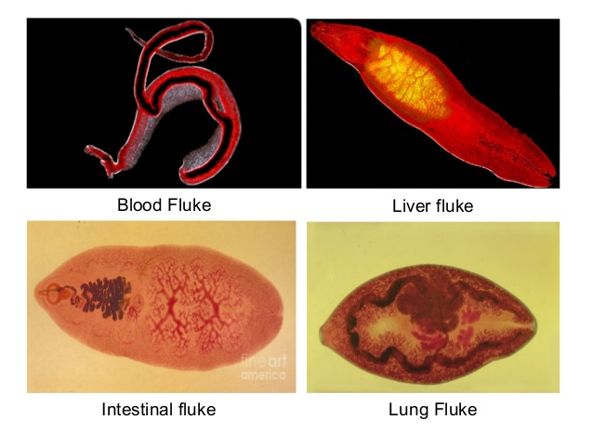

Slide 10
TREMATODES (FLUKES) CONT’D
In all these flukes, the infective stage for humans is the metacercariae.
The Flukes of Medical importance belong to the Subclass Digenea of the Class Trematoda. Digenetic flukes have the following features:
Two generations in their life cycle, namely:
1. An asexual generation in which multiplication occurs (in sporocysts or redia stage, and
2. A sexual generation which produces eggs

Slide 11
TREMATODES (FLUKES) CONT’D
Unsegmented, mostly flat leaf-like worms (except schistosomes)
Attach to their host by means of suckers (an oral sucker surrounding the mouth and a ventral sucker on the ventral surface).
Digestive system consists of a mouth and an oesophagus which divides to form two intestinal caeca.
In some species the caeca are branched. There is no anus.

Slide 12
TREMATODES (FLUKES) CONT’D
Excretory system is composed of excretory cells (called flame cells), collecting tubules and an excretory pore, this is not the anus.
Hermaphroditic (male and female reproductive organs in the individual) except schistosomes.
Most trematode eggs are operculated (i.e. have lids).
The eggs must reach water in order to develop.

Slide 13
TREMATODES (FLUKES) CONT’D
The hermaphroditic flukes live either in the liver or bile ducts, lungs or the intestine by virtue of the organ of adult worm residency.
Animal reservoir hosts are important in the transmission of some species
Transmission is by ingestion of infective metacercariae which develop into the adult and produce operculated eggs.
These are passed out in the faeces of definitive hosts. Each egg hatches a miracidium

Slide 14
TREMATODES (FLUKES) CONT’D
The first intermediate host is a snail in which the miracidium develops into a sporocyst which produces rediae.
Some species produces more than one generation of rediae. Rediae produce cercariae which are shed from the snail
A second intermediate host is used in case of some species and this can be a fresh water fish, crab, cray fish or water plant.
In or on these hosts, cercariae encyst and become metacercariae.

Slide 15
1.Opisthorchis sinensis (or Chlornorchis sinensis)
This is commonly known as the Chinese or Oriental liver fluke.
Distribution
Endemic in most of China, also in Japan, North Vietnam, Taiwan and Korea.
Particularly found where fish are cultured in ponds fertilized with human or animal faeces.
Transmission
By eating raw insufficiently-cooked, smoked or pickled fish containing the metacercariae.

Slide 16
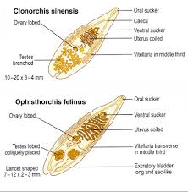

Slide 17
1.Opisthorchis sinensis (or Chlornorchis sinensis)
Life cycle
Following ingestion, metacercariae excyst in the duodenum.
Young flukes that survive digestion migrate to the bile duct and occasionally the pancreatic gut where in approximately four weeks they develop into mature egg producing flukes

Slide 18
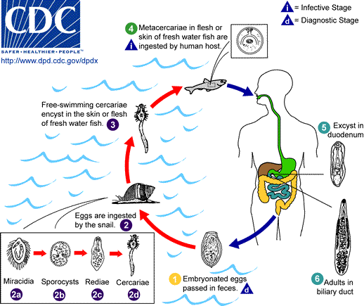

Slide 19
Life cycle of Opisthorchis sinensis
Eggs enter the small intestine in the bile and are excreted in the faeces.
Each egg contains a fully developed miracidium
Eggs must reach fresh water to continue the life cycle. A suitable snail host e.g. Bulinus or Melanoides or Parafossaiulus ingests the eggs

Slide 20
Life cycle of Opisthorchis sinensis cont’d
The eggs hatch in the snail into miracidia which develop into sporocyts and in turn producing rediae and finally cercariae.
Cercariae leave the snail and swim in the water for a few hours and then encyst to become metacercariae under the scales and in the subcutaneous tissue of a suitable fish host.
Many species of fish can serve as intermediate hosts, especially those of the family Cyprinidae and Anabatidae

Slide 21
Life cycle of Opisthorchis sinensis cont’d
Metacercariae are infective to humans and other fish eating animals
e.g. dogs, cats, pigs, rodents.

Slide 22
Symptoms and Pathology of Opisthorchis sinensis
Generally the symptoms are rarely serious
Heavy infections can result in damage to liver cells and bile ducts, jaundice, hepatitis, cirrhosis and biliary obstruction.
The liver frequently enlarged and in some cases cancer (adenocarcinoma) of the bile duct may develop

Slide 23
Symptoms and Pathology of Opisthorchis sinensis cont’d
Other symptoms include epigastric pain and diarrhoea.
Chronic infections is associated with gall stones, recurrent attack of cholangitis and pancreatitis

Slide 24
Prevention and control of Opisthorchis sinensis
Avoiding eating raw, pickled, smoked or insufficiently cooked fish
Provision of adequate latrines and health education to prevent contamination of fish ponds and water bodies
Non-use of untreated faeces as fertilizer in fish ponds
Application of molluscicides to kill snail hosts in infested water bodies.

Slide 25
1.Opisthorchis sinensis cont’d
Diagnosis
Examination of faeces for eggs
Examination of aspirates of duodenal fluid for eggs

Slide 26
TREMATODES (FLUKES) CONT’D
Opisthorchis viverrini
This is a species similar to O. sinensis. It is found in the Mekong River valley in Laos and in Thailand where it is the commonest trematode infection.
Opisthorchis felineus is normally parasitic in dogs, cats but can also infect humans. It occurs in Europe, Japan and Siberia. It is similar to O. sinensis in all aspects.

Slide 27
TREMATODES (FLUKES) CONT’D
Excretory system is composed of excretory cells (called flame cells), collecting tubules and an excretory pore.
Hermaphroditic (male and female reproductive organs in the individual) except schistosomes.
Most trematode eggs are operculated (i.e. have lids).
The eggs must reach water in order to develop.

Slide 28
Fasciolopsis buski
It is the largest fluke that infects humans. It is the giant intestinal fluke.
The normal definitive hosts are the pig and buffalo.
Distribution
The disease, Fasciolopsis is widespread in the Far East and occurs also in Indonesia and where water plants are cultivated in ponds fertilized by pig or human faeces.

Slide 29
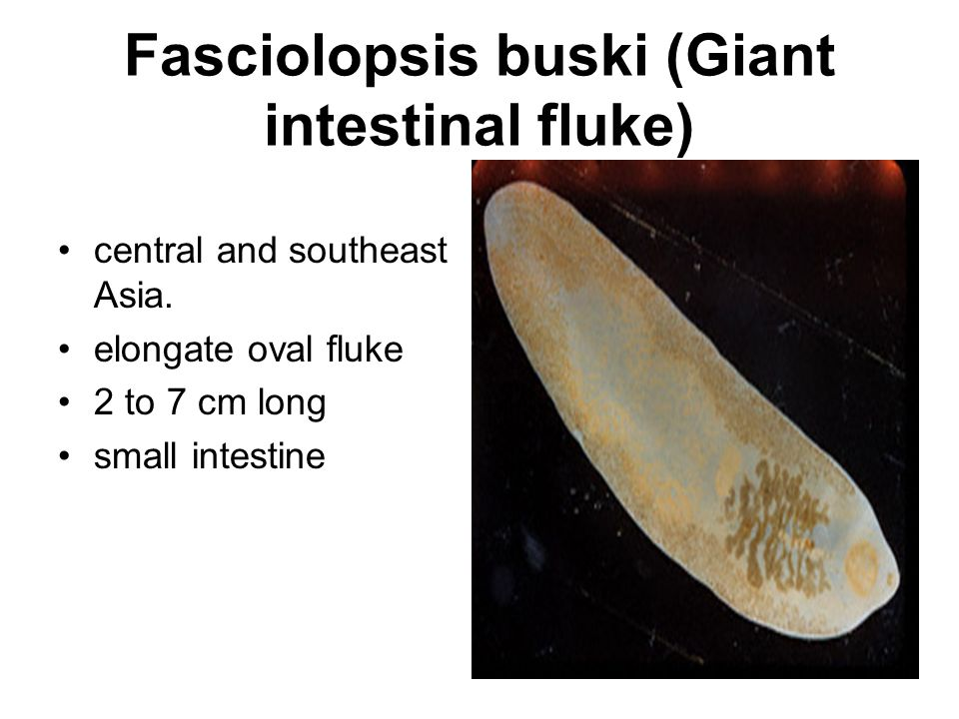

Slide 30
Fasciolopsis buski cont’d
Infection rates are particularly high in school children.
Transmission
The metacercariae excyst in water plants, water chestnut or the fruits of water plants or vegetation.
Infection occurs when these are eaten.

Slide 31
Life cycle of Fasciolopsis buski
Life cycle
After intake, metacercariae excyst in the duodenum, attach themselves to the wall of the small intestine and in three months develop into mature egg producing adults, producing many eggs.
Immature eggs are passed out in the faeces, each of which contains an unsegmented ovum surrounded by many yolk cells

Slide 32
Life cycle of Fasciolopsis buski cont’d
Eggs must reach fresh water and after a few weeks hatch miracidia which swims in search of snails of the genus Segmentina or Hippeutis
Miracidia develop in the snail host, into sporocysts which in turn, produce two or more generations of rediae and finally cercariae all in about 2 months.

Slide 33
Life cycle of Fasciolopsis buski cont’d
Cercariae are shed from the snail and swim till they reach suitable water plants and excyst as metacercariae which are infective to humans, pigs and buffalo
Adults live only a few months.

Slide 34
Symptoms and Pathology of Fasciolopsis buski
Often infection is symptomless, however, inflammation, ulceration of the intestinal wall, with abdominal pain and diarrhoea may occur.
Large numbers may cause haemorrhage
Symptoms of malabsorption may develop with pale coloured and offensive faeces.
Heavy infections in children may cause symptoms resembling protein caloric malnutrition with wasting

Slide 35
Symptoms and Pathology of Fasciolopsis buski cont’d
Toxins produced by the worms may cause oedema of the face and limbs, ascites (accumulating of fluid in the peritoneal cavity) and allergic reactions
Plasma albumin levels may fall due to protein loss
Usually, blood eosinophilia occurs

Slide 36
Prevention and Control of Fasciolopsis buski
Cooking or treating water plants well before eating
Identifying faeces contaminated pond or water bodies containing edible water plants. Including not irrigating vegetables with such contaminated water.
Provision of toilet facilities and health education to prevent eggs from reaching water bodies.

Slide 37
Prevention and Control of Fasciolopsis buski cont’d
Avoiding use of human/pig faeces as fertilizer
Identifying and destroying snail intermediate host habitats
Where possible, clearing water vegetation on which cercariae excyst

Slide 38
Fasciolopsis buski cont’d
Diagnosis
Examination of faeces for eggs and sometimes also the flukes (adults)

Slide 39
Fasciola hepatica and F. gigantica
These are important pathogens of humans and other animals.
They live in the liver and bile ducts of sheep, cattle and other animals, and cause liver rot.
F. gigantica infections in cattle cause gigantic economic loss.
Human infections are occasional, leading to the disease Fascioliasis. F. hepatica infection is more common than that of F. gigantica

Slide 40
Fasciola hepatica and F. gigantica
Distribution
F. gigantica is found mainly in Africa and the Far East with cattle, camels and water buffaloes being more infected
F. hepatica is worldwide but especially found in temperate countries.
It is also found in S. America, Cuba and Africa with sheep, cattle and other herbivores being commonly infected.

Slide 41
Fasciola hepatica and F. gigantica
Transmission
Caused by eating wild watercress or edible aquatic vegetation on which metacercariae encyst.
Life cycle
After intake, metacercariae excyst in the duodenum and the young flukes migrate through the intestinal wall into the peritoneal cavity and reach the bile ducts of the liver by penetrating through the liver capsule

Slide 42
Life cycle cont’d
3-4 months after the infection, eggs are passed in the faeces, these hatch in 1-2 weeks in water into miracidia which enter the appropriate snail host, genus Lymnaea
The species of snails which are the intermediate hosts of F. gigantica are aquatic whereas those of F. hepatica are amphibious

Slide 43
Life cycle cont’d
Miracidia develop into sporocysts within the snail and sporocysts produce generations of rediae and finally cercariae, which are shed by the snail and encyst on water vegetation or grass.

Slide 44
Symptoms and Pathology
Light infections are usually without symptoms; heavy infections cause liver damage, especially during the migratory phase
Chronic infections lead to thickening of the bile ducts due to a cellular response by the host
The worms may develop in other parts of the body

Slide 45
Symptoms and Pathology cont’d
Usually there is fever, pain, a marked blood eosinophilia and urticaria.
The liver may enlarge and bile ducts blocked leading to obstructive jaundice

Slide 46
Prevention and Control
Avoiding edible aquatic vegetables (watercress) not sufficiently cooked as they may contain metacercariae
Reducing infection by fencing off grazing land known to be infested with metacercariae
Treating infected animals to reduce egg output
Identifying and destroying snail habitats where this is possible.

Slide 47
Fasciola hepatica and F. gigantica cont’t
Diagnosis
Examination of faeces and duodenal fluid aspirates for eggs
Testing serum for antibodies in response to the worm’s antigens

Slide 48
Heterophyes heterophyes
A small fluke normally parasitic in the intestine of cats, dogs, foxes, wolves and jackals.
Distribution
Human infection mainly occurs in the Far East and the Nile Delta in Egypt
Transmission
Eating raw or insufficiently cooked fish containing the metacercariae.

Slide 49
Life Cycle of Heterophyes heterophyes
After intake, metacercariae excyst and develop into mature egg- producing adults in the small intestine.
The eggs contain a fully developed miracidium when passed in faeces.
In water, the eggs are ingested by snails of the genera Pirenella or Cerithidia

Slide 50
Life Cycle of Heterophyes heterophyes
Miracidia hatch in the snail from the egg and develop into sporocysts which produce rediae and finally cercariae.
Cercariae leave the snail and encyst on fish such as mullet or minnow, as metacercariae
The encysted metacercariae are infective to fish eating animals and to humans.

Slide 51
Heterophyes heterophyes cont’d
Symptoms and Pathology
There are few serious symptoms apart from intestinal inflammation and necrosis
Rarely, eggs may reach the heart and CNS to produce serious symptoms

Slide 52
Heterophyes heterophyes cont’d
Prevention and Control
By not eating insufficiently cooked or pickled fish which may contain the metacercariae.
Diagnosis
Examination of the faeces for small eggs of the parasite

Slide 53
Metagonimus yokogawai
The smallest fluke infecting humans
It lives in the small intestine
Has reservoir hosts: dogs, cats, pigs and pelicans.
Distribution
Far East and the Mediterranean region

Slide 54
Metagonimus yokogawai cont’d
Transmission
Similar to that of H. heterophyes. Snail hosts belong to the genera Seniisulcospira and Thiara. The second intermediate hosts are Cyprinid fish and Sweetfish.
Symptoms and Pathology
Most infections are asymptomatic
Heavy infections may cause inflammation of the intestinal wall with abdominal pain and watery diarrhoea

Slide 55
Metagonimus yokogawai cont’d
Prevention and Control
Not eating insufficiently cooked or pickled fish which may contain the metacercariae.
Diagnosis
Examination of the faeces for small eggs of the parasite.

Slide 56
Dicroceoelium dendriticum
A small fluke usually parasitic in the biliary tract of sheep and cattle. Human infection is rare.
Distribution
China, Africa, S. America and Europe.
Transmission and Life Cycle
Spurious infection (resulting from ingestion of infected beef or sheep (liver)), occasionally.
Human infection is by accidentally swallowing ants which may contain metacercariae.
Metacercariae develop into mature egg-producing flukes in the bile ducts and liver

Slide 57
Dicroceoelium dendriticum cont’d
Symptoms and Pathology
Symptoms are rarely serious
Diagnosis
Examination of the faeces for eggs and of aspirates of duodenal fluid for the eggs.

